Slide 1
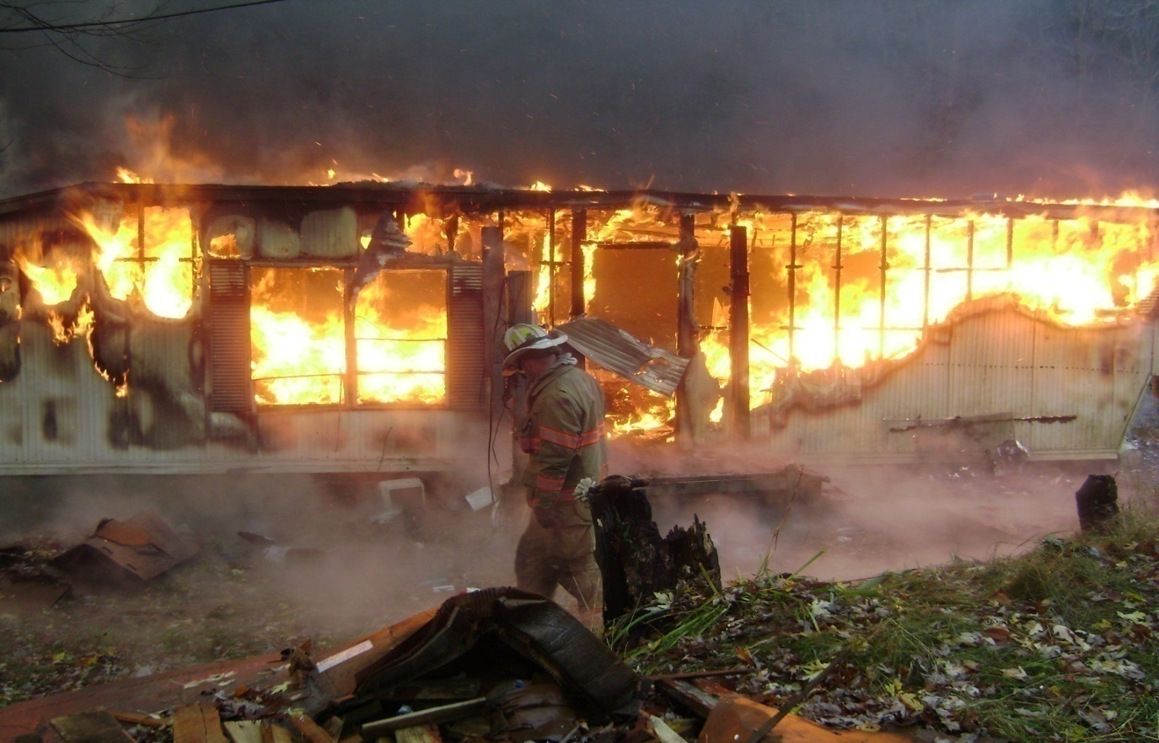
Smoke Alarms:
The Fire That
Started It All

Slide 2
Introduction
Russell Ashe
Captain / EMT – I
Fire Service for 19 Years

Slide 3
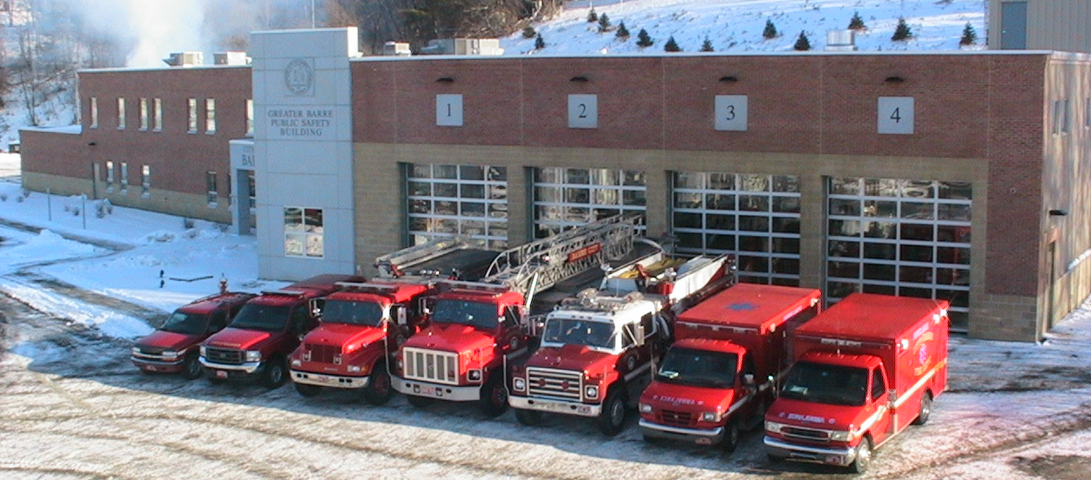
Barre City Fire Department
18 - Full Time Firefighter (IAFF Local 881) & 20 - Call Firefighters
City Population - 9600
4 Duty Shifts - Rotation of 24 Hours ON DUTY 72 Hours OFF DUTY
EMS LEVEL - Intermediate - Paramedic

Slide 4

What Got Us Started ?
December 17, 2005

Slide 5
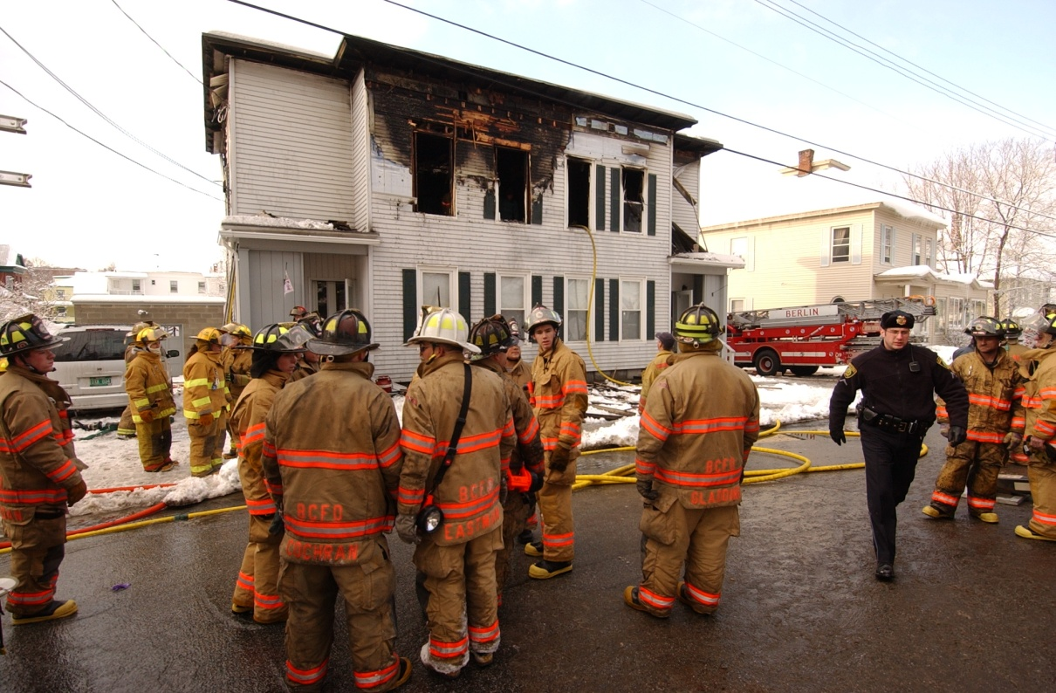
Eastern Ave.
Call Received 5:58 am
7 people in the home at the time of the fire.
1 Adult male was able to escape by reportedly jumping out of a second floor window.
Fire Crews rescued 4 Children and the Father before being consumed by fire.
Tragically the 4 children and there mother died from smoke inhalation.

Slide 6
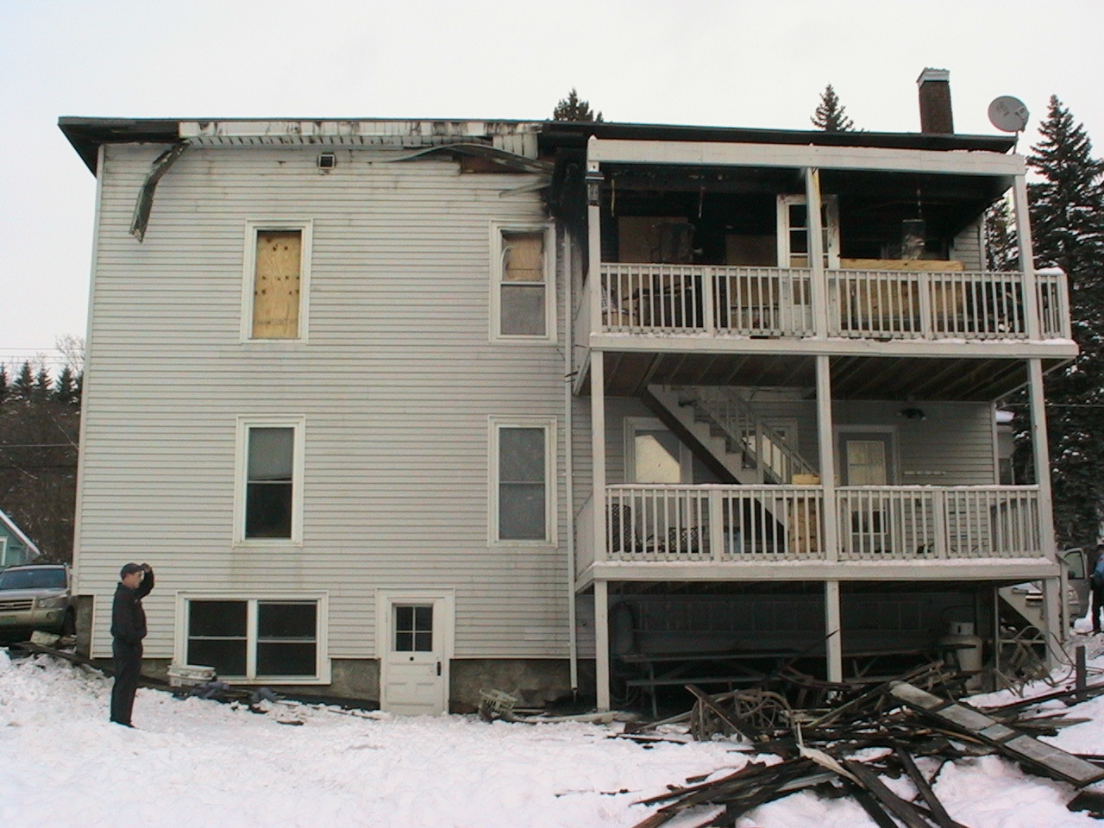
Notes:
C side of building where adult male was rescued and where crews entered to conduct their searches.

Slide 7
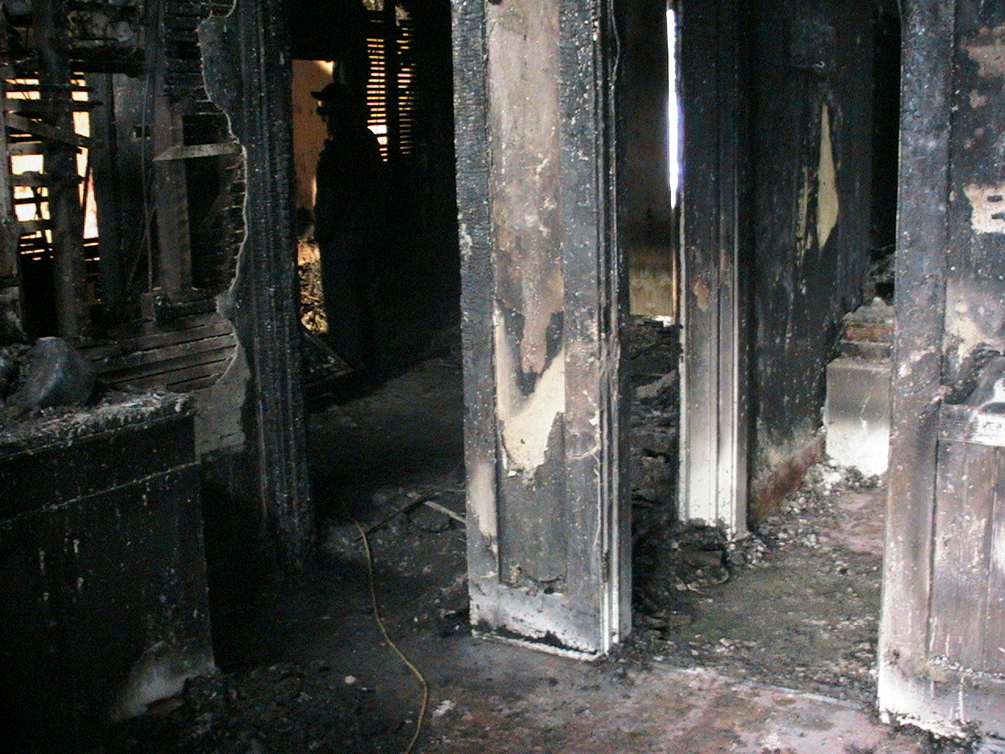
Notes:
View from C side porch where rescue was initiated. Crews made it in thru the living room and to the dinning room before being forced out of the building.

Slide 8
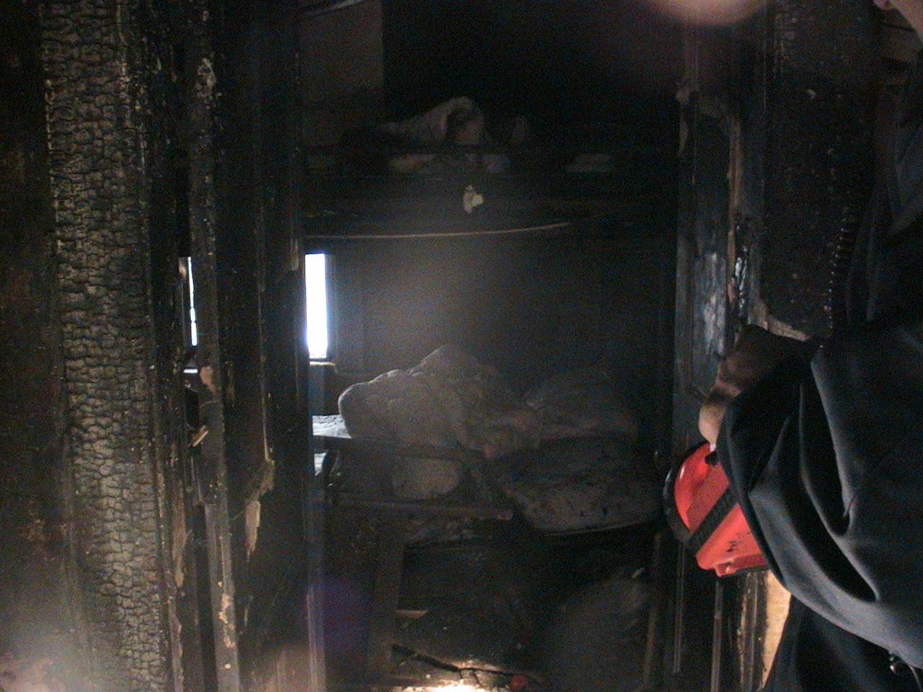
Notes:
Bunk beds in the girls room.

Slide 9
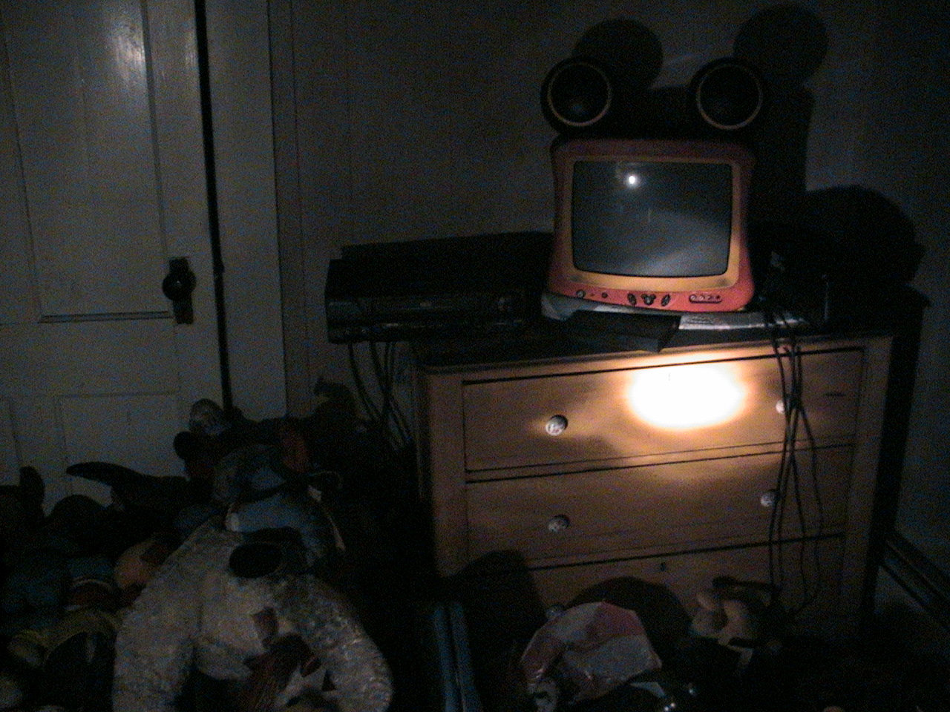
Notes:
Brett’s room. There was very little smoke damage in this room.

Slide 10
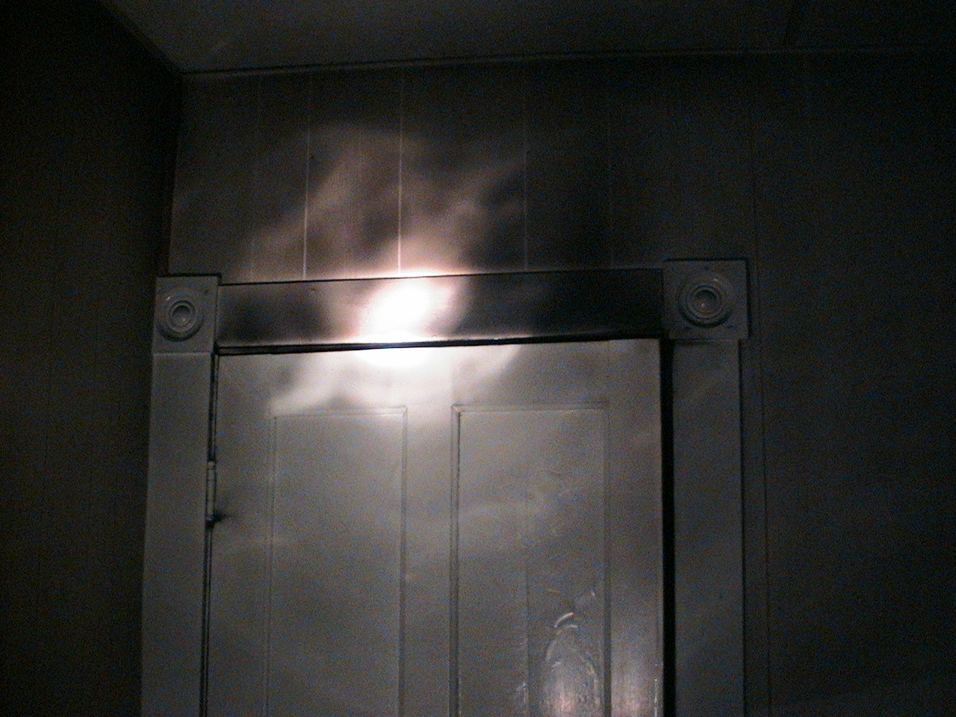

Slide 11
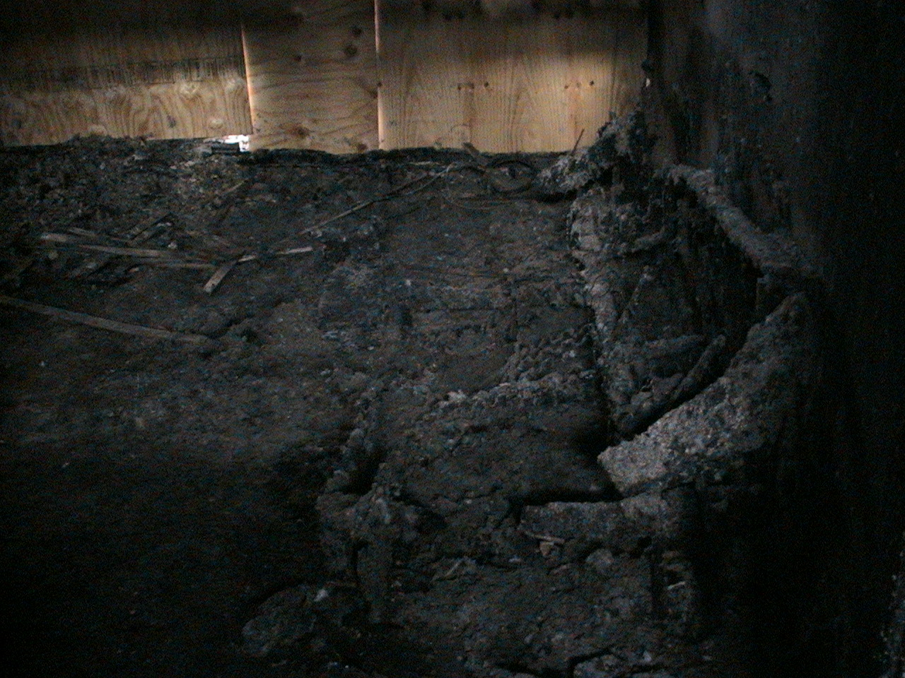
Point of Origin
Possible Causes:
Smoking Material, Christmas Decorations, or Unattended Candle

Slide 12
Investigation
According to a male survivor - the smoke in the apartment was so heavy he was forced to jump from a second floor window.
The male victim that escaped reported that he heard no smoke detectors going off while he was in the apartment.
The apartment had 3 HARD WIRED IONIZATION smoke detectors
(1 in the Master Bedroom, 1 in the Girls Bedroom, and 1 in the main family room)
All smoke detectors on the first floor were found to be in working order by firefighters after the fire was extinguished.
The apartment building had passed a city minimum housing inspection only a few months before this fire.

Slide 13
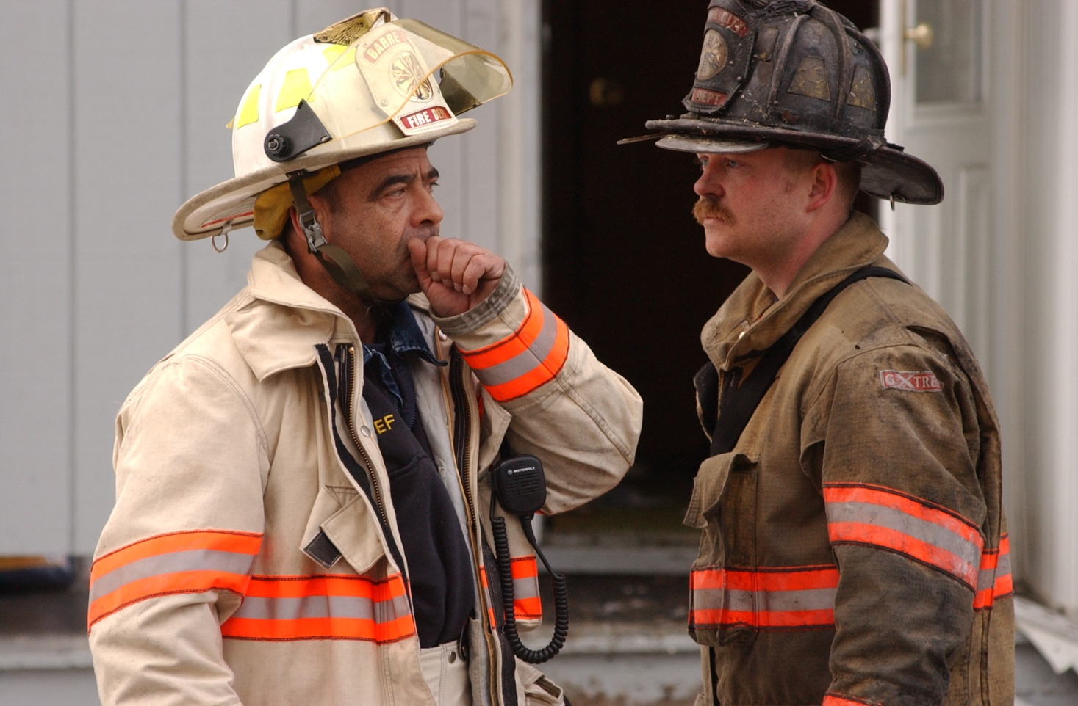
What Happened?
Why Did The Alarms Not Go Off?

Slide 14
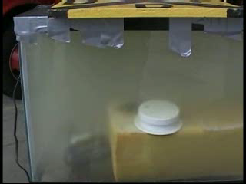

Slide 15
A fish aquarium
is NOT
a real representation
of a house fire ! ! ! !

Slide 16
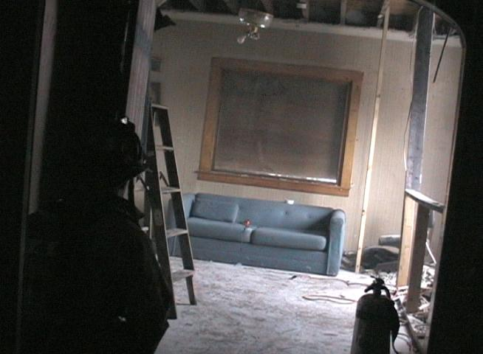
Barre City Fire Department
Full Scale Smoke Detector Test

Slide 17
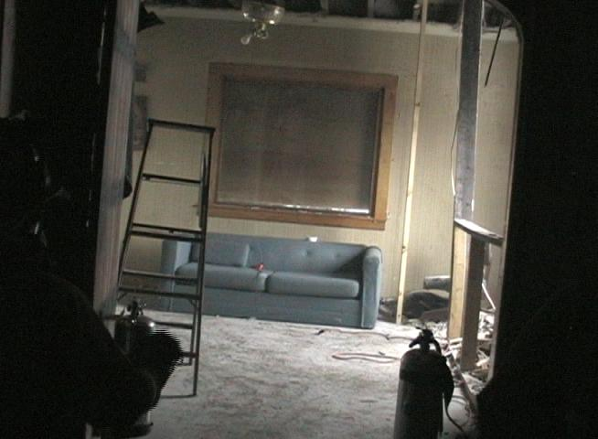
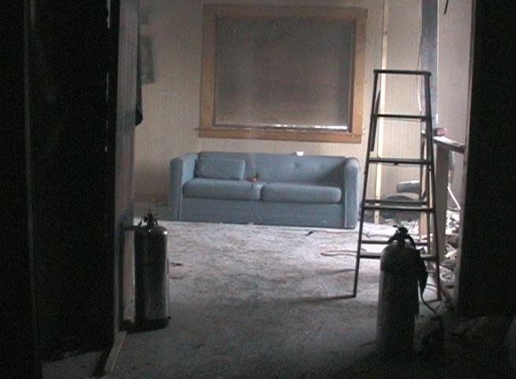
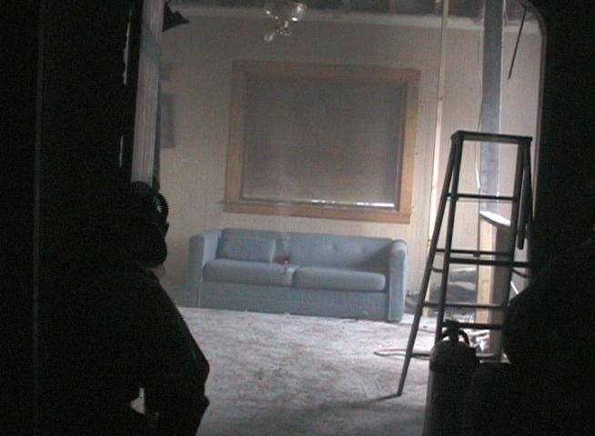
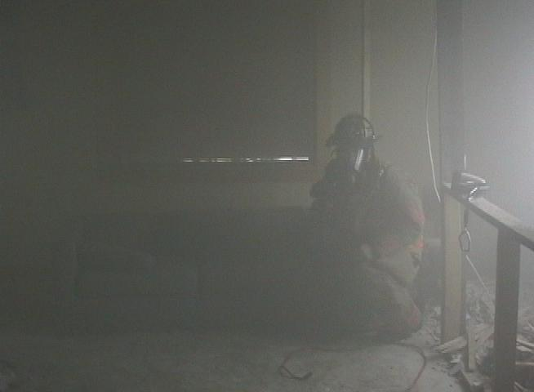
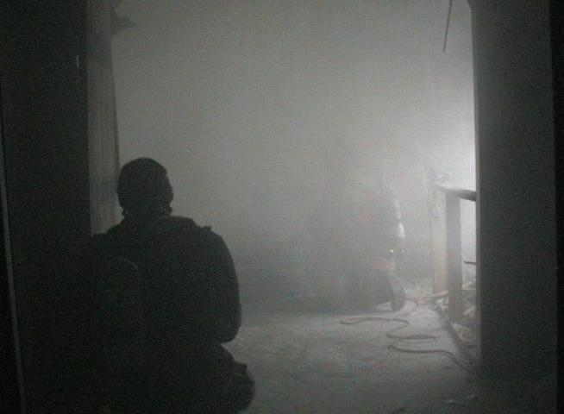
Photoelectric / CO Detector
11 Minutes
Photoelectric / Ionization Detector
15 Minutes
Photoelectric Detector
23 Minutes
Photoelectric Detector
27 Minutes
Ionization Detector beeped 4 times then shut off
1 Hour
Ionization Detector
1 Hour - 6 Minutes

Slide 18
First Photoelectric
11 Minutes
Ionization
1 Hour 6 Minutes

Slide 19
S.226
Winter of 2007 / 2008, Senate Bill 226 is introduced and debated, requiring Photoelectric Only smoke alarms to be installed in all new single family dwellings and any existing single family dwellings sold.
Photoelectric Only smoke alarms would be required in the area of the bedrooms and at least one per floor.

Slide 20
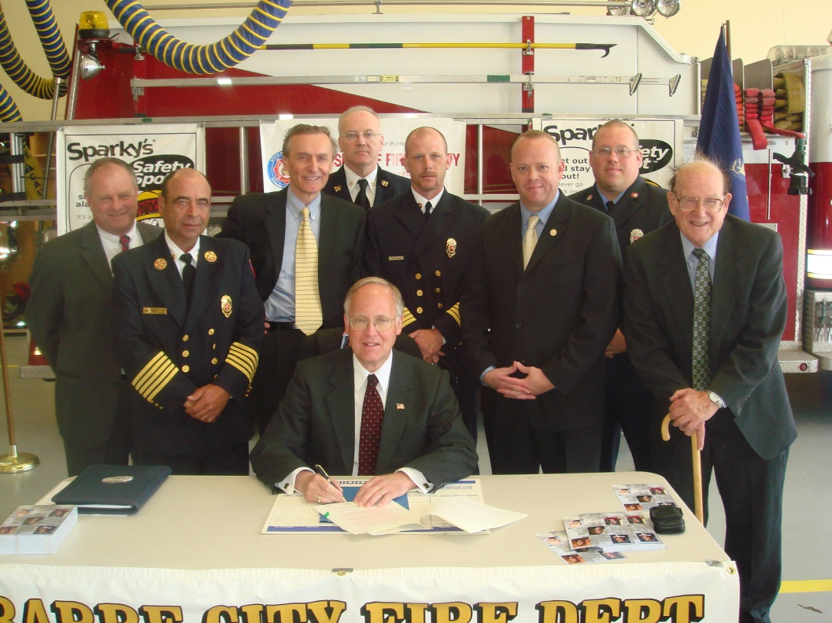
May 2008
Senate Bill 226 is signed into law requiring Photoelectric only smoke alarms

Slide 21
LET US NOT FORGET THE TRUE HERO’S

Slide 22
DAVENPORT, IOWA
JANUARY 18, 1993
BRADLEY MERCER

Slide 23
ROTTERDAM, NEW YORK
MAY 31, 2001
BILL HACKERT
CHRISTINE HACKERT

Slide 24
WAIHI, NEW ZEALAND
MARCH 23, 2003
SUE O’SULLIVAN
MICHAELA ZONNEVELD
JENNY ZONNEVELD
JASON ZONNEVELD
JEANETTE ZONNEVELD

Slide 25
OHIO STATE UNIVERSITY
APRIL 13, 2003
ANDREA DENNIS
KYLE RAULIN
AL SCHLESSMAN
ERIN DEMARCO
CHRISTINE WILSON

Slide 26
SCOTCHTOWN, TASMANIA
APRIL 2004
JOSHUA COHEN
CLAIRE POKE
TAYLA BRAID
DANNI WIGG

Slide 27
MIAMI UNIVERSITY
APRIL 10, 2005
JULIE TURNBULL
KATE WELLING
STEVE SMITH

Slide 28
BARRE CITY, VERMONT DECEMBER 17, 2005
BRETT STOLTZ
TORY STOLTZ
CHRISTA FOSTER
KIMBERLY STOLTZ FOSTER
MIKAYLA FOSTER

Slide 29
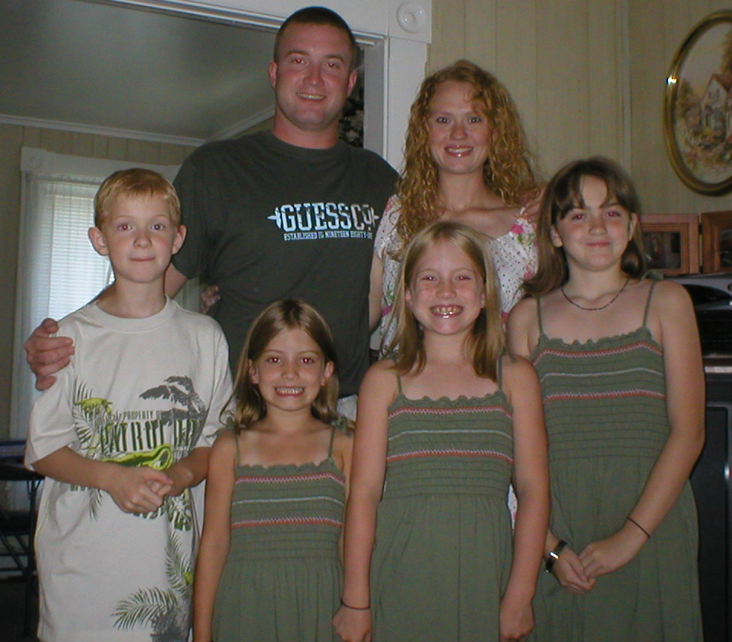

Slide 30

Help Us Make A Difference
LT Matthew J. Cetin – Firefighter / EMT
Barre City Fire Department
15 Fourth St. Barre Vt. 05641
(802) 476-0254
Mcetin@Barre City Fire.org
Captain Russell Ashe – Firefighter / EMT
Barre City Fire Department
15 Fourth St. Barre Vt. 05641
(802) 476-0254
RASHE@Barre City Fire.org

